Slide 1
Software Tools in Data Science
Michael Reid

Slide 2
The “Data” in Data Science
How do you do the following with data?
Data ingestion
Data storage
Data processing
Notes:
Kaggle competitions vs real world
lots of different options for each of these; no one “correct” solution

Slide 3
About Me - Mike Reid
Bachelor’s of Science in Mathematics from University of Maryland
10 years of software development experience
Most recently, software engineer with machine learning focus at Splunk
Stream data processing, analytics, and ML

Slide 4
Presentation Overview
Deep dive into the logistics of the “data” of “data science”
Provide high-level overviews of the software used modern data pipelines and processing
Notes:
why should you care?
data is messy in real life
pipelines are complicated
issues like redundancy, server failures, backups, message duplication and reprocessing
end goal is an overview of modern data pipelines and the tools within

Slide 5
Data Ingestion
How do we get data from a source into our system for further processing?
Mailing physical hard drives - this still happens in 2017
Still need an import process; and it’s slow
The internet
Lots of different ways to do it over the internet, though
Notes:
data source can be anything: web server logs, internet of things sensor data
dealing with the internet makes you think about latency, network outages, how that impacts your data

Slide 6
Data Ingestion - The Old-fashioned Way
Your data source for analytics and data science is same as the one for online transaction processing (OLTP); always see the latest data
This is simple, but very limited. Need history
{ "user": 123, "first_name": "John", "start_date": "2015/01/01", "salary": 45000 }
Notes:
for an ecommerce website you only need the latest price, but for analysis you’d want historical data
sample problem - working for an HR/recruitment firm, want to analyze employee data

Slide 7
Data Ingestion - Events
Many modern software architectures are built around events
Every action in the system produces an event, which can be consumed by any interested software systems
{ "type": "EmployeeStarted", "date": "2015/01/01", "user": 123, "salary": 30000 }
{ "type": "EmployeePromoted", "date": "2017/05/01", "user": 123, "old_salary": 30000, "new_salary": 45000 }
Notes:
mention CQRS/ES briefly
how do we build an event-driven software architecture?

Slide 8
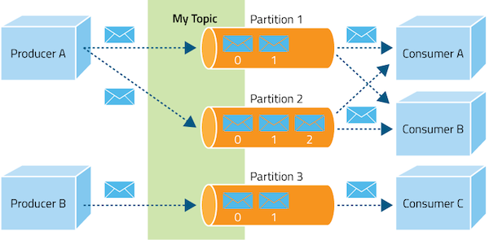
Data Ingestion - Message Queues
Notes:
the stuff on the left is a source, could be anything (web server)
the green and orange parts are our message queue
consumers can be anything; let’s say it’s our analytics app, or just a notification server
decoupling
note the idea of having buffers for all of the senders

Slide 9
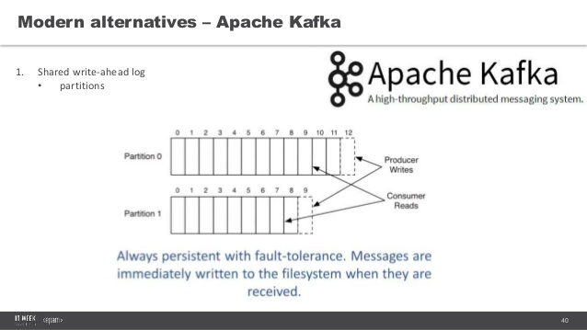
Data Ingestion - Message Queues (cont)
Legacy - exactly once delivery - RabbitMQ, ActiveMQ, MSMQ, Amazon SQS
All based on a model where consumers must acknowledge a message
Modern - at least once delivery - Apache Kafka or Amazon Kinesis
Based on publish/subscribe -- scales much better because of looser delivery requirements
Notes:
legacy message queues are based around acknowledgement and EXACTLY ONCE delivery
three types of delivery: exactly once, at most once, at least once

Slide 10
Data Ingestion - Splunk/Elasticsearch
Splunk and Elasticsearch are two popular “all-inclusive” solutions
Great for situations where you don’t have control of the schema so data ingestion needs to be more flexible
Splunk can read many common log file formats, such as Apache/nginx web server logs, Unix syslogs, etc.
The downside of flexible ingestion is more difficult analysis

Slide 11
Data storage
How to store data is a big, difficult question
Big data is hyped up but often unneeded
You can rent out an AWS instance with 2TB of RAM and do everything in memory
Anything less than 20TB and an RDBMS or document database like Mongo is sufficient
Real example: ow.ly, Hootsuite’s link shortener, is a single 20TB MySQL database

Slide 12
Data Storage - The Filesystem
Less than 8GB in size can fit in memory on a laptop
Less than 2TB in size can fit in memory on AWS
Ideal for one-off operations on data
For example, a one-time operation to run sentiment analysis on customer feedback over the past quarter
Pros:
Virtually no setup
Fastest I/O
Cons:
No data backups
Doesn’t scale, both data and process-wise

Slide 13
Data Storage - Cloud Filesystems
If you’re doing everything in the cloud, this can give you all the benefits of a big data system but far simpler
Amazon S3, Azure Blob Storage, Google Cloud Storage
Cons:
If you have a lot of data (tens/hundreds of TB), can be cost prohibitive

Slide 14
Data storage - Relational Databases (RDBMS)
Ancient and battle-tested; still the best option for storing structured data
Possible in newer database engines to store unstructured data efficiently as well -- see PostgreSQL’s JSONB data type
Plenty of options for reliability and security of data
Backups
Replication
Notes:
MySQL, MSSQL, Oracle

Slide 15
Data Storage - RDBMS - SQL
Regardless of how far we’ve come, SQL is still the king of data science tools
99% of all enterprise data is still stored in SQL databases
SQL is still great at answering common data science questions
“Business Intelligence” vs “Data Science”
Notes:
we’ll look at SQL examples later

Slide 16
Data Storage - Hadoop
Hadoop is the king of big data storage
Comes in multiple flavors: Cloudera, Hortonworks, MapR
It’s powerful, but complicated to set up, maintain and use

Slide 17
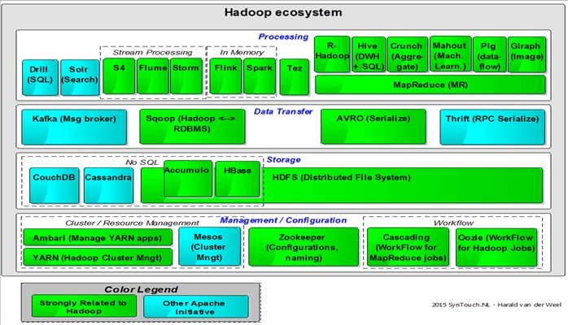
Data Storage - Hadoop - What is it?
Hadoop is an ecosystem rather than a single piece of software

Slide 18
Data Storage - Hadoop - HDFS
The core piece of any Hadoop cluster is HDFS, the Hadoop Distributed Filesystem
Replicated
Can be distributed across many nodes, and the number of nodes can be adjusted at runtime

Slide 19
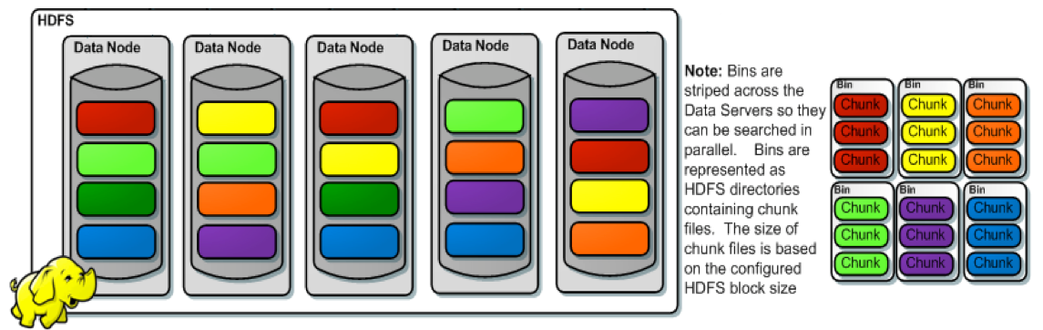
Data Storage - HDFS - How is data stored?
Notes:
each color is a different file
files are distributed across nodes; you don’t know where those nodes are
have to use some sort of interface (like a hadoop UI or API) to work with the data

Slide 20
Data Storage - Hadoop - HDFS (cont)
Accessing data in HDFS is not so simple -- your data is distributed across multiple nodes, you don’t know where they reside
Enter “MapReduce”
Map phase -> run an operation on every node
Reduce phase -> run an operation on the result of every map operation
Example: Given a petabyte of numbers distributed across a cluster, what’s the largest number?
Notes:
this is the most important process for big data analysis, mapreduce

Slide 21
Data Storage - Splunk/Elasticsearch
Splunk and Elasticsearch can store massive amounts of data
These are log and event data storage systems; the primary use case is when you’re dealing with time

Slide 22
Data Storage - Splunk
Splunk operates on the concept of “buckets”, which are files on the filesystem that contain (temporal) data
If any data ever comes in without a timestamp, one is assigned that is equal to ingestion time
As a bucket ages, it gets moved from “hot” or “warm” to “cold”
Cold buckets are typically put in a non-local location--access is slower
“Cold” eventually moves to “frozen”
Can be either permanently deleted or archived
All this operates on the assumption that newer data is more valuable

Slide 23
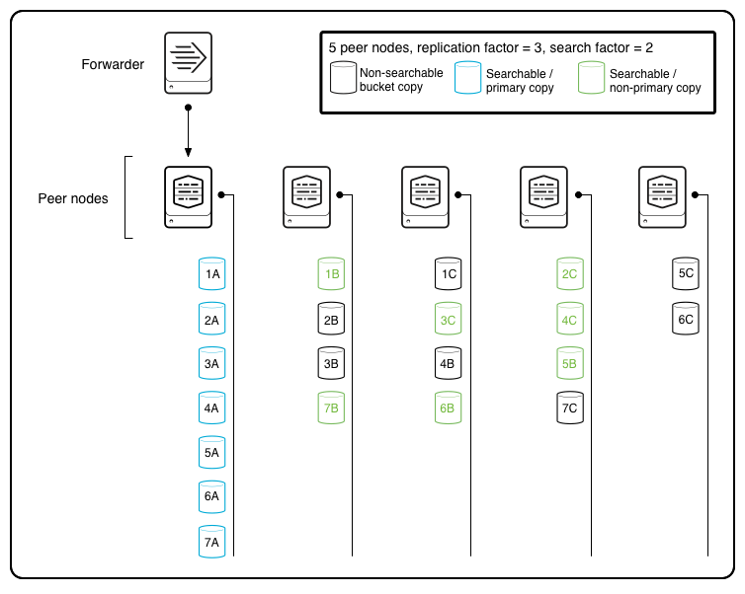
Data Storage - Splunk - Replication
Notes:
just a basic overview of Splunk’s data storage; somewhat similar to Hadoop in that data is replicated across several servers

Slide 24
Data Processing - Overview
Data processing has changed drastically in the past decade
Used to focus on powerful, but expensive, high-performance computing labs with extremely fast disk I/O and network interconnect (e.g. Infiniband); low-level code written in C with MPI
Now is more about using elastic, resilient infrastructure on commodity hardware with less efficient but much easier to develop code written in Python, Java, or Scala
Notes:
“what’s the relevance of this to data science?”

Slide 25
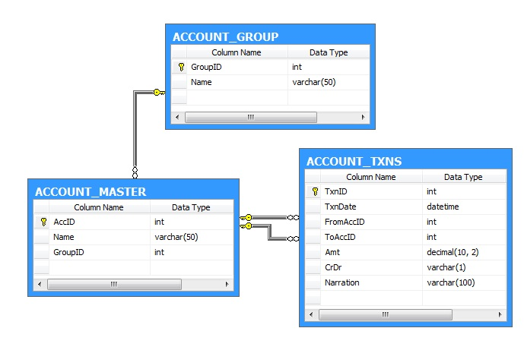
Data Processing - RDBMS & SQL
Relational databases are built around the concept of tables, which have a schema of columns with data types
Tables are filled with rows of data
SQL is a declarative language using set-based logic to extract data from a relational database
A lot of power comes from the ability to join data sets

Slide 26
Data Processing - SQL Examples
Get the names of all accounts
SELECT Name FROM account_master
Get all transactions from or to a given account
SELECT * FROM account_txns WHERE FromAccID = @accId OR ToAccID = @accId
Show group ID of all outgoing transactions
SELECT GroupID, TxnID FROM account_group LEFT JOIN account_master ON account_group.GroupID = account_master.GroupID LEFT JOIN account_txns ON account_master.AccID = account_txns.FromAccID
Get the number of accounts in each group
SELECT GroupID, COUNT(GroupID) FROM account_master GROUP BY GroupID

Slide 27
Data Processing - MapReduce (redux)
The most important fundamental concept in distributed data processing
Map - run an operation on all nodes in a cluster
Reduce - take the results of a map operation and perform some aggregation on them
Thinking about where your operations are running, in the physical world, relative to the data, is the key to performance: data locality
Notes:
drilling home map reduce because it’s so important
data locality is key

Slide 28
Data Processing - Partitioning and Shuffling
Data partitioning is separating data into different streams or nodes based on a value within the data
Analyzing user session behavior from web traffic logs: partition by user ID
Performing housing price analysis: partition by region
A shuffle operation involves moving all data to different nodes to match the partition key appropriate for the problem
Extremely expensive! Goal is to do this once per data pipeline
Notes:
in the real world you almost never have to look at the whole data set at the same time to do something meaningful

Slide 29
Data Processing - Partitioning Example
{ "time": "2012-04-23T18:25:43.511Z", "rig": 10005, "widget": "pressure_gauge", "kpi": 123.45 }
Notes:
oil rig example
how do you partition this data?

Slide 30
Data Processing - Partitioning Example (cont)
Answer is (almost) always “It depends”
“Is each oil rig producing values that are anomalous relative to yesterday?” - Partition by oil rig ID
“Is any oil rig producing values that are anomalous relative to other oil rigs?” - Partition by widget type
Notes:
* always frame your problem first before making any technical decisions!

Slide 31

Data Processing - Spark
One of the most widely-used and battle-tested distributed data processing frameworks
Works with Hadoop out of the box, but can run standalone
Features:
Fault-tolerant - loss of a node won’t impact results
Horizontally scalable
Job scheduling - ideal for multiple data scientists sharing resources
FOSS

Slide 32
Data Processing - Spark Example
lines = spark.read.text(sys.argv[1]).rdd.map(lambda r: r[0]) counts = lines.flatMap(lambda x: x.split(' ')) \ .map(lambda x: (x, 1)) \ .reduceByKey(add) output = counts.collect() for (word, count) in output: print("%s: %i" % (word, count))
Notes:
you’d take this piece of code and use a command line tool (spark-submit) to run it on a Spark cluster

Slide 33
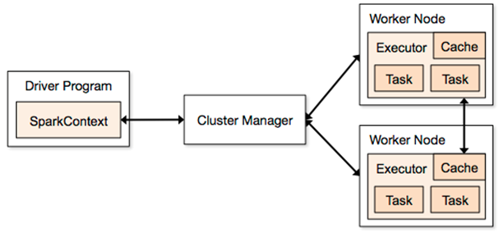
Data Processing - Spark Architecture
Notes:
you’re actually shipping your source code to the spark cluster, which is why you can’t just have arbitrary python (or scala or java) code; need to think about library dependencies, and code being serializable
especially if you’re using python with C bindings

Slide 34
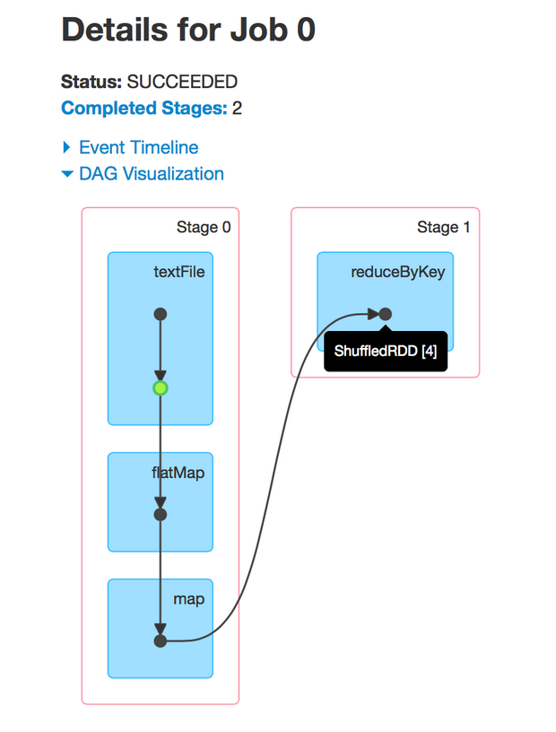
Data Processing - Spark RDDs
A RDD is resilient distributed dataset, the fundamental data structure in Spark
When working with Spark and RDDs, have to be aware that you don’t have the full dataset on a single node
Spark converts your code to directed acyclic graph (DAG) that represents a chain of operations on RDDs

Slide 35
Data Processing - Other Spark APIs
Spark has a few APIs built on top of RDDs that are more convenient
The Dataset and Dataframe APIs are intended for data that has a schema; works at the row level
These APIs enable Spark SQL, which allows for SQL-ish operations on your data
lines = sc.textFile("examples/src/main/resources/people.txt") parts = lines.map(lambda l: l.split(",")) people = parts.map(lambda p: Row(name=p[0], age=int(p[1]))) teenagers = sqlContext.sql("SELECT name FROM people WHERE age >= 13 AND age <= 19")

Slide 36
Data Processing - Spark MLlib
Spark MLlib contains a large number of ML algorithms that can be run on Spark; can be combined with normal Spark operations
Combine data cleaning and ML into one job
Supports model persistence
Notes:
talk about chaining data cleaning operations into an ML algorithm

Slide 37
Data Processing - Spark MLlib Example
# Loads data. dataset = spark.read.format("libsvm").load("data/mllib/sample_kmeans_data.txt")
kmeans = KMeans().setK(2).setSeed(1) model = kmeans.fit(dataset) # Shows the result. centers = model.clusterCenters() print("Cluster Centers: ") for center in centers: print(center)

Slide 38
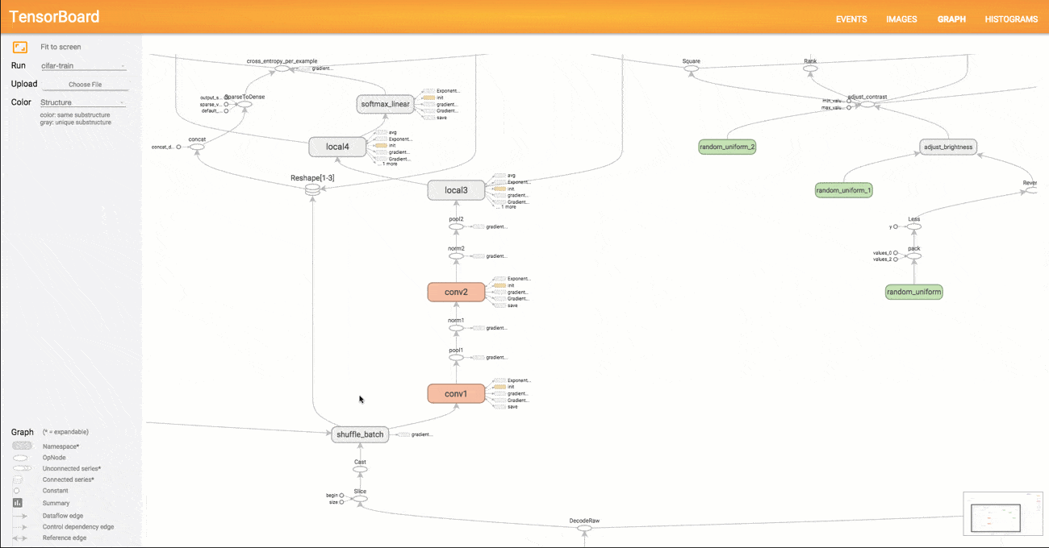
Data Processing - Tensorflow
In some ways, Tensorflow is very similar to Spark - it also takes your code and generates a DAG of operations (can use TensorBoard to visualize)

Slide 39
Data Processing - Distributed Tensorflow
Spark’s primary use case is distributing computation effort across multiple nodes (CPUs) in a cluster
Distributed Tensorflow can run across CPUs, but also natively supports GPU execution - ideal for speeding up matrix and vector operations (deep learning)

Slide 40
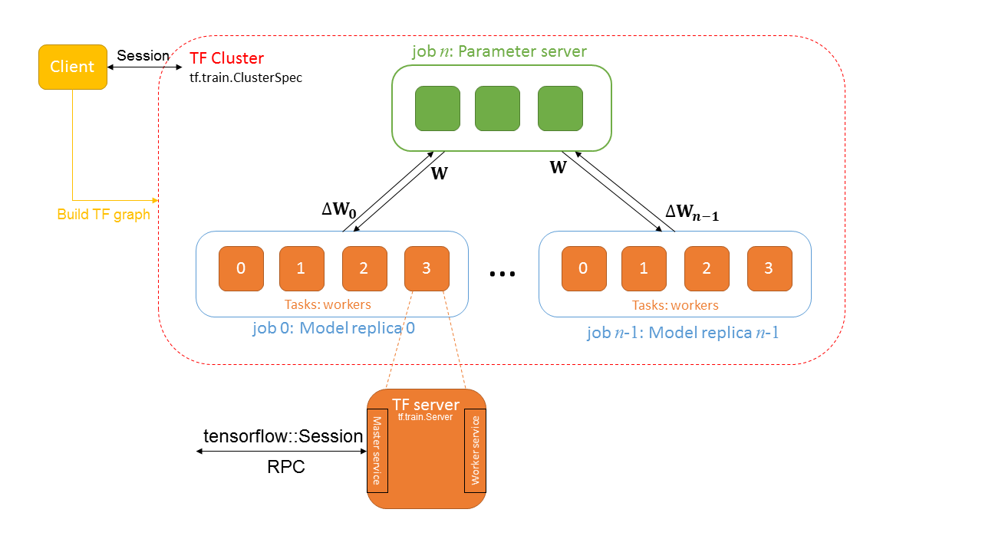
Data Processing - Distributed Tensorflow (cont)
Notes:
client - the tensorflow code you write (construct a TF graph)
“TF Cluster” - a set of nodes dedicated to one particular task, like training a neural network (this is not normal terminology)
job - a list of Tasks
task - one single tensorflow process
parameter server - stores parameters (network optimization as opposed to putting them in the workers)
master service - RPC service, coordinates work across worker services
worker service - executes parts of the Tensorflow graph

Slide 41
Data Processing - Tensorflow Serving
One of the big advantages of Tensorflow is a feature called Tensorflow Serving, which is an API that exposes Tensorflow models
Also handles model versioning
Allows other people or software to use your model to make predictions
Notes:
this is a big advantage over Spark etc, which don’t expose their model really

Slide 42
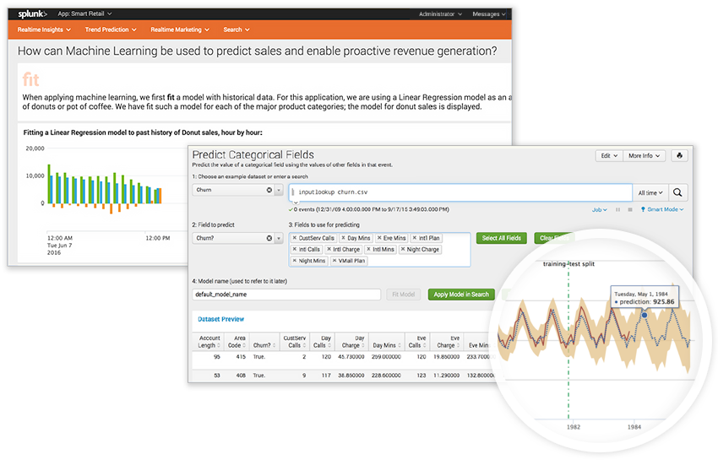
Data Processing - Splunk
For general data processing, Splunk has “SPL”, a powerful custom language
For ML, Splunk provides the Machine Learning Toolkit

Slide 43
Data Processing - Streaming
Batch processing is currently the most common use case for data science and machine learning
... but it won’t be in 5 years
Stream processing can answer all the questions that batch processing can, and much more

Slide 44
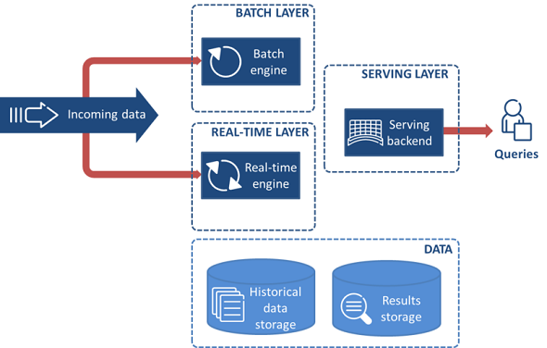
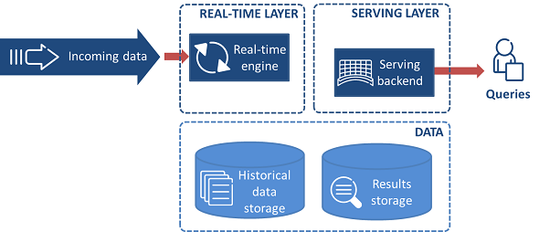
Data Processing - Lambda and Kappa
Notes:
lambda is about splitting incoming data into two pipelines, one for real-time processing and one for batch
kappa uses modern tools like Spark Streaming, Apex and Flink to get rid of the batch layer entirely

Slide 45
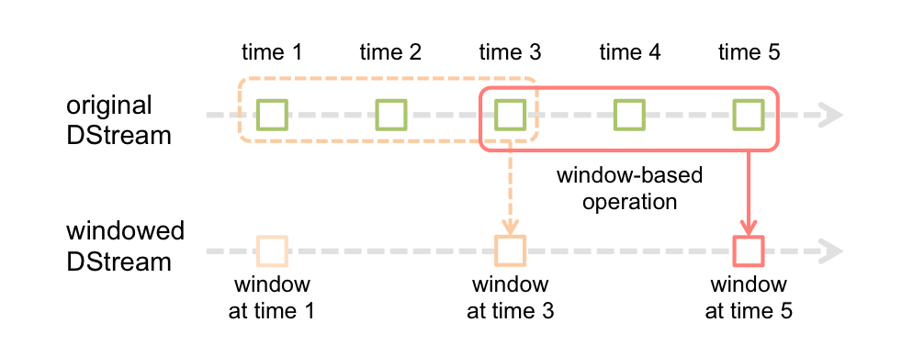
Data Processing - Spark Streaming
Runs on the same infrastructure as Spark, with the same fundamental concepts; a data stream (“DStream”) is just a chain of RDDs
“Fake” streaming - runs as microbatches (typically ~2 seconds)
Notes:
can hook up to Kafka as a data source

Slide 46
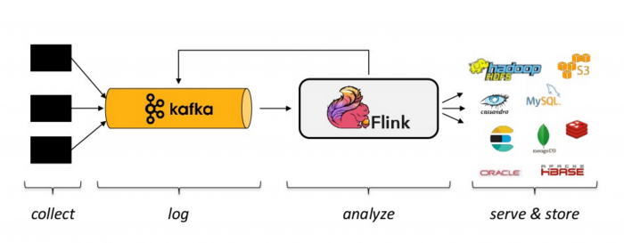
Data Processing - Apache Flink
A new, native streaming framework that’s picking up steam
Takes a user-written program and builds a DAG to execute
Typically is hooked up to a message queue (like Kafka)

Slide 47
Data Processing - Streaming ML
Most ML algorithms are still written for batch processing, not streaming
Existing algorithms can be adapted to work “online” by using hybrid batch-streaming approach
Requires you to think about the outputs
e.g. Clustering - how do you ensure consistent cluster IDs in K-means or DBSCAN? If existing data changes cluster membership how do you communicate that?

Slide 48
Data Processing - Streaming ML - Sequences
Sequence processing algorithms are in high demand for streaming ML
Hidden Markov models
Recurrent neural networks (in stream mode)
Use case: detecting fraudulent activity at a bank via web traffic logs, ATM withdrawal logs
Use case: detecting malfunctioning equipment
Notes:
high demand but there aren’t many out there

Slide 49
Other things to think about
Labeling unlabeled data
Interns? Mechanical Turk? Crowdflower?
Where’s your data coming from?
Synthetic data generation -- potentially great lab results, poor real-world results
Data cleaning
Date formats, clock drift
Visualization
Splunk
D3.js

Slide 50
The End
Thank you!

